Slide 1
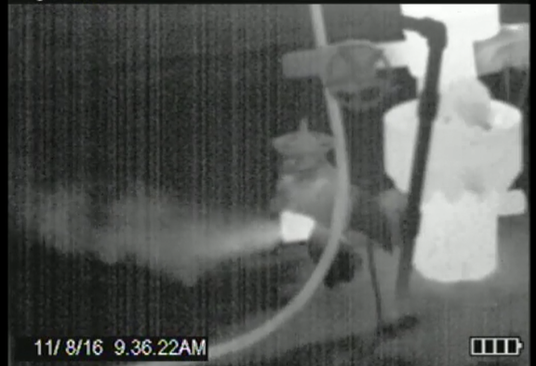
Proposed Oil and Gas Regulations
A Significant Step in Addressing
Air Pollution and Climate Change
in Canada
Notes:
Storage tank: regular picture in the center – no leaks visible, though you could probably smell them;
Picture at left: Image taken with infrared camera used for leak detection – you can see the leaks coming out of the vents at the top of the tanks.
Picture at right: infrared image of escaping gas from well casing

Slide 2
PROPOSED METHANE REGULATIONS

Slide 3
Protecting the Health and Environment of Canadians
Unprecedented level of consultations
In December 2016, the Pan-Canadian Framework on Clean Growth and Climate Change identified these regulations as part of actions that will contribute to achieving our Paris 2030 target
There will be significant air quality benefits
Methane measures for upstream facilities lead to reductions in VOCs
ECCC is also fulfilling its legal obligation reduce carcinogenic VOCs from downstream facilities

Slide 4
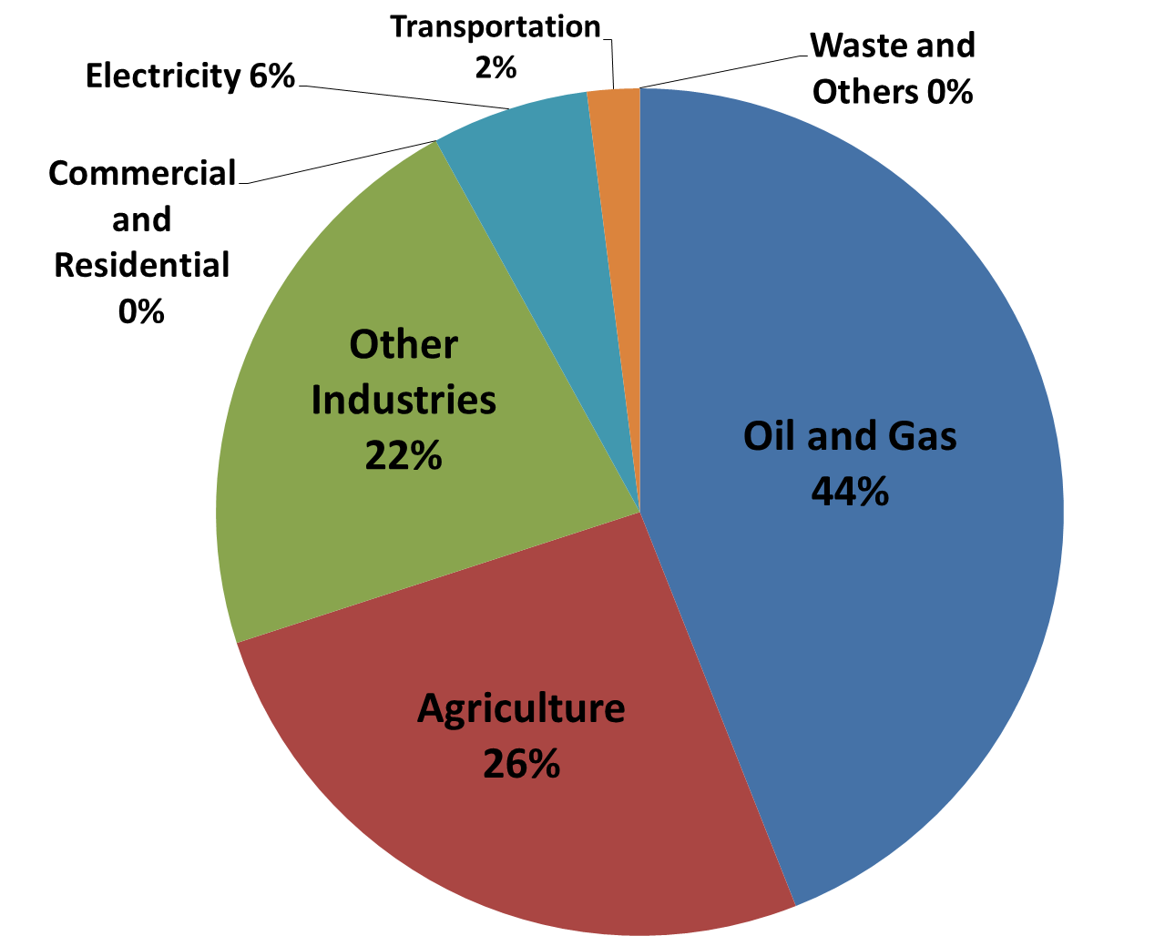
Methane
What is it?
Colorless, odorless, flammable gas
Primary component of natural gas
Global warming potential 25 times greater than CO₂ over a 100-year period
Short-lived climate pollutant – relatively short lifetime in the atmosphere and has a warming influence on climate
Canada’s 2014 Total Methane Emissions (110 Mt CO₂e)
48 Mt
CO₂e

Slide 5
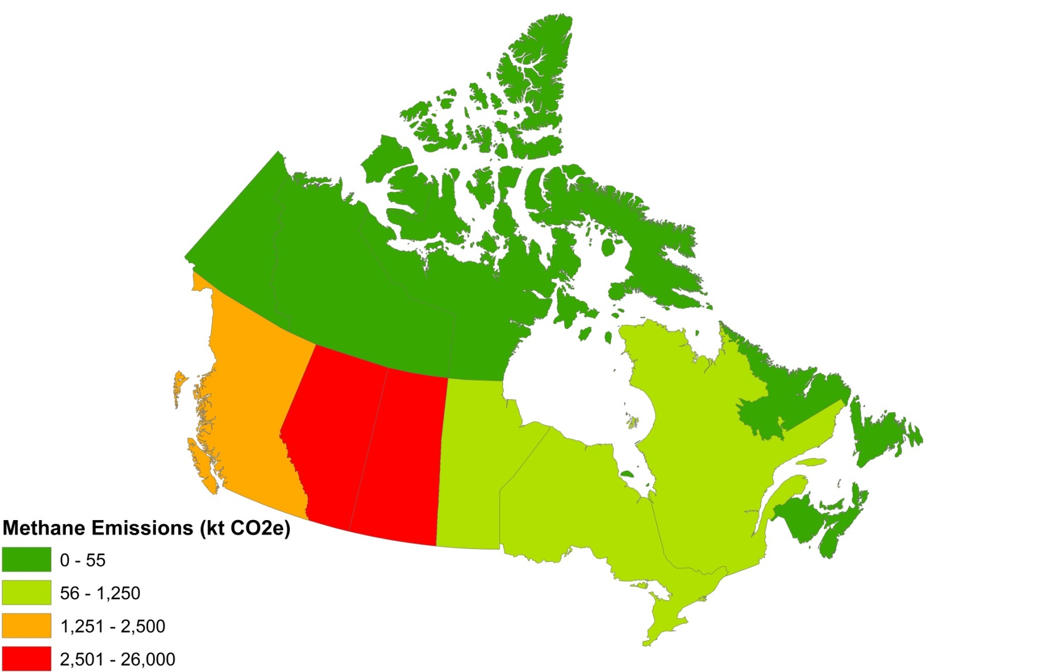
Oil and Gas Methane Across Canada
Source: National Inventory Report

Slide 6
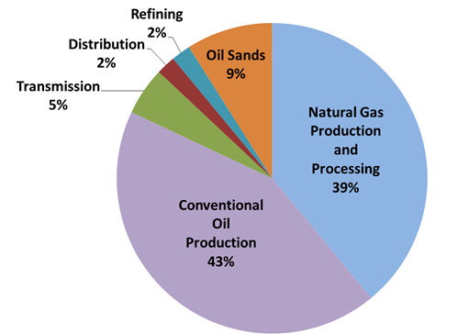
Proposed Regulatory Coverage
The proposed regulation covers over 95% of methane emission sources:
Natural Gas Production and Processing
Conventional Oil Production
Transmission
Most oil sands emissions
A small portion of the sector’s emissions are not covered:
Distribution
Refining
Some oil sands emissions
Canada’s Oil and Gas Sector Methane Emissions
Source: National Inventory Report

Slide 7
Proposed Regulatory Approach
Regulations under Canadian Environmental Protection Act, 1999 (CEPA)
Methane emission limits are being proposed in 5 key areas:
Fugitive equipment leaks
Venting
Pneumatic devices
Compressors
Well completions
Require corrective actions (equipment repairs, gas combustion and gas conservation)
Utilize existing provincial reporting structures when possible, such as production accounting systems

Slide 8
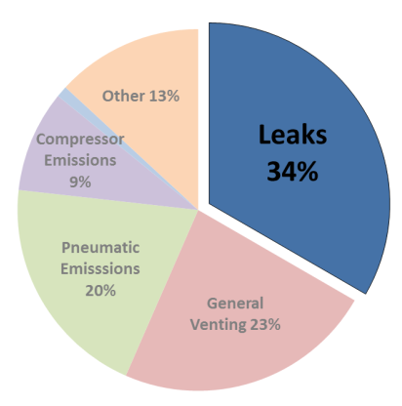
1. Leak Detection and Repair (34% of methane oil and gas emissions)
Establish and maintain emission control program to detect and repair gas leaks
Element | Proposed Approach
Coming Into Force | 2020
Coverage | Larger facilities
Frequency of Inspection | 3 times per year
Inspection Methods | Infrared cameras, sniffers, innovative methods e.g. satellites, drones, etc.
Timelines for Repair | Offshore: 365 days Onshore: within 30 days, or next shutdown
Exemptions | Single Wellheads

Slide 9
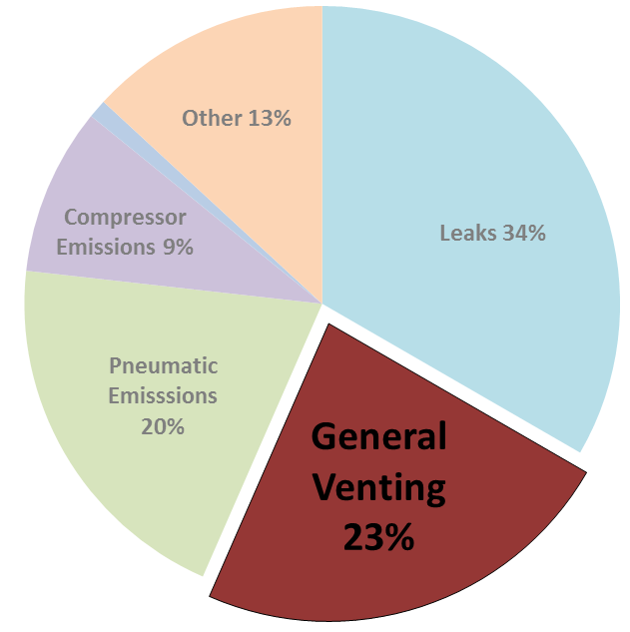
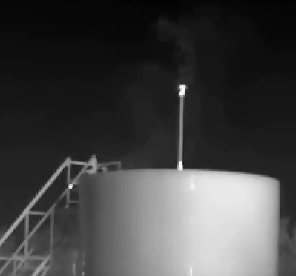
2. Venting (23% of methane oil and gas emissions)
Restrict venting of gas => Reduce emissions by 95%
Rely on current provincial reporting activities
Element | Proposed Approach
Coming Into Force | 2023
Coverage | Larger facilities
Maximum allowable venting limit | 3000 m³/year
Exemptions | None for regular operation; emergency venting only
Reduction Method | Conservation or flaring / clean incineration
Intentional venting from thief hatch on storage tank

Slide 10
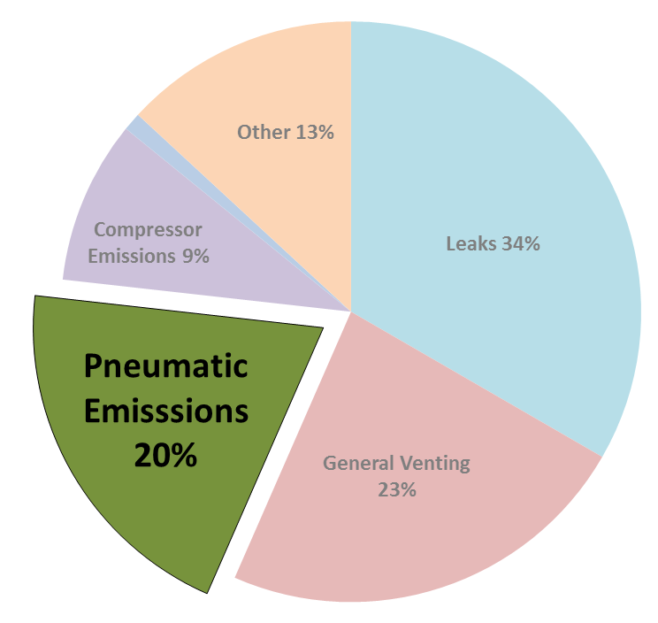
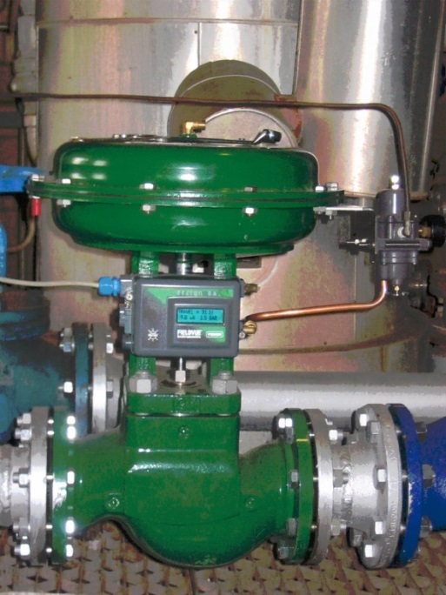
3. Pneumatic Devices (20% of methane oil and gas emissions)
A pneumatic device is an automated instrument (usually natural gas-driven) widely used in oil and gas industry for maintaining a process condition, such as liquid level, pressure, pressure difference and/or temperature
non-emitting controllers for larger facilities; low-emitting for smaller facilities
non-emitting pneumatic pumps for larger pump rates
Element | Proposed Approach
Coming Into Force | 2023
Coverage | Larger facilities and pumping rates
Exemptions | Controllers: exemptions possible for operational needs Pumps: exemption permits if no feasible non-emitting technology Both where emissions are conserved or destroyed
Reduction Method | Controllers: switch to non- or low-emitting Pumps: switch to non-emitting

Slide 11
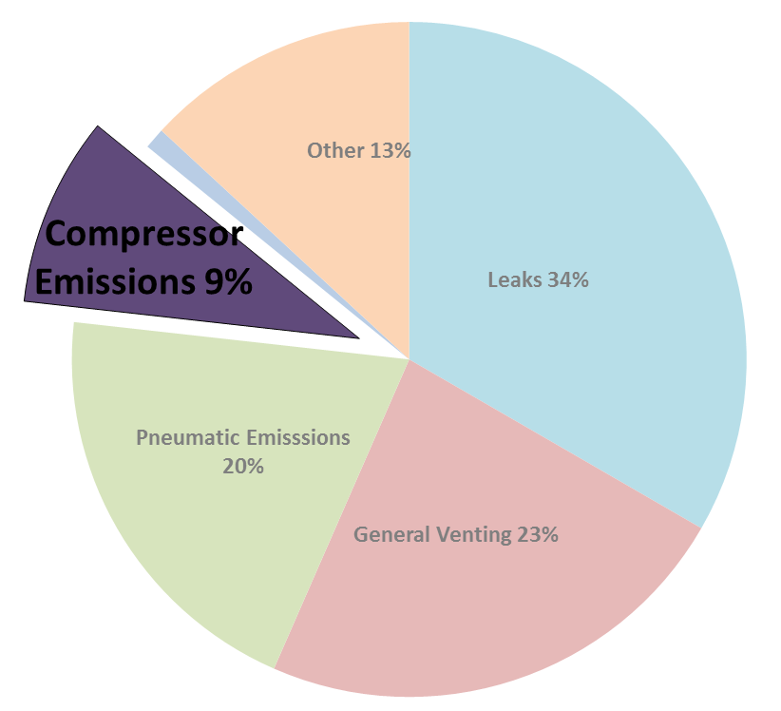
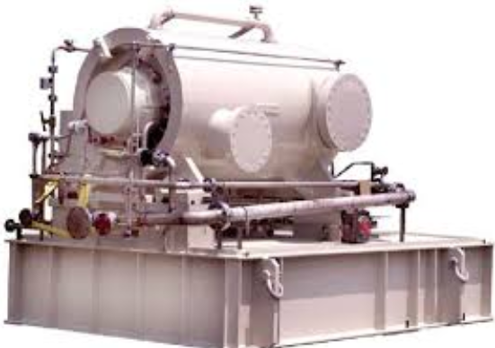
4. Compressors (9% of methane oil and gas emissions)
A compressor is a mechanical device that increases the pressure of natural gas and allows the gas to be transported from the production site, through the supply chain, to the consumer
Requires annual measurements of compressor vents
Element | Revised Proposed Approach
Coming Into Force | 2020
Coverage | Existing compressors must meet limits, new compressors must conserve emissions
Limit | Based on compressor type
Corrective Action Timelines | 30 or 90 days based compressor type
Measurement | Annually
Exemption | No measurement required if emissions conserved or destroyed

Slide 12
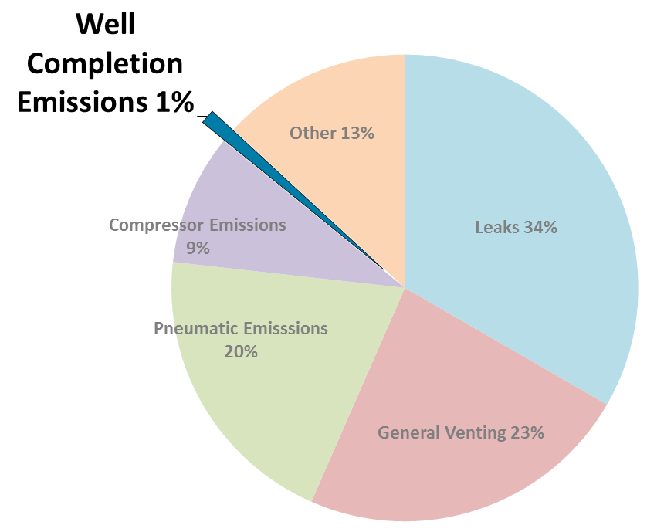
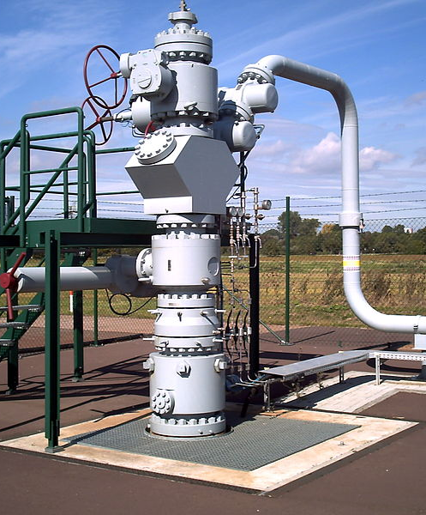
5. Well Completions by Hydraulic Fracturing (1% of methane oil and gas emissions)
Prohibits venting at facilities during fracturing operations at oil and gas wells
Element | Revised Proposed Approach
Coming Into Force | 2020
Coverage | Fractured wells with high gas-to-oil ratios
Reduction Action | Conservation or Flaring / Clean Incineration
Exemption | Alberta and British Columbia

Slide 13
Collaborating with Partners and Stakeholders
Provinces/Territories
Extensive consultations with Western provinces to ensure coordinated action on methane and to inform development of federal approach
ECCC negotiated a “co-development framework” to facilitate discussions
As a result, key changes made to original ECCC proposal, including adjusting proposed coming into force dates to facilitate potential for equivalency or administrative agreements
ECCC working with NS and NL governments, offshore boards and industry regarding implementation of the requirements offshore
Industry
ECCC actively worked with industry on regulatory approach and adjusted proposed coming into force dates, providing more lead time for industry to plan for changes and spread out costs over time
ENGOs
Extensive consultation with environmental organizations, such as the Pembina Institute, Environmental Defense Fund and Clean Air Task Force
Indigenous Peoples
ECCC met with the key groups with a focus on First Nations oil and gas issues such as the Indian Resource Council and Indian Oil and Gas Canada to explain the draft proposed regulations in detail
Notes:
The views of provinces and territories have varied based on the importance of the sector and on the potential impacts of the regulation on their environmental and economic objectives.

Slide 14
Anticipated Costs and Benefits
Reducing methane is lowest cost GHG-related abatement opportunity in energy sector
EDF / ICF: estimated average cost: C$2.76/tonne CO₂e
ECCC: estimates average cost: C$10/tonne CO₂e
Significant air quality co-benefits from the VOC reductions this regulation will bring about (not factored into the cost analysis)
Avoided climate change damages expected for proposed reductions are valued at $13.4 billion over 2018-2035 (reduction of 282 megatonnes of CO₂e)
Value of conserved gas estimated at $1.6 billion over this period
The currently wasted gas equals amount used in SK for home heating
The proposed regulation is similar to, or less stringent than, existing US Federal and State regulations, whose coverage of total production is much greater than Canada’s
Costs for oil and gas industry estimated at $3.3 billion over the same period
0.4% of estimated cumulative industry expenditures ($700 billion) over 2018-2035
Expected net benefits of $11.7 billion over 2018-2035
Notes:
We are working with the provinces and territories and the energy sector to provide the flexibility it needs to cost-effectively cut methane emissions. Through innovation in clean technology, Canada’s oil and gas sector can become a global leader in responsible energy production

Slide 15
PROPOSED VOC
REGULATIONS

Slide 16
Volatile Organic Compounds (VOCs)
Canada is taking action to improve air quality by limiting releases of VOCs from large downstream oil and gas facilities, such as refineries, upgraders as well as some petrochemical facilities
VOCs are air pollutants that contribute to the formation of smog, which is known to have adverse effects on human health and the environment
A group of VOCs called “petroleum and refinery gases” pose a particular risk to Canadians’ health because they may contain carcinogenic substances, such as benzene and 1,3-butadiene
These gases were declared toxic to human health by Government of Canada as Canadians living and working in the vicinity of certain oil and gas facilities can be exposed to them
Government of Canada has a legal obligation to take steps to reduce the risks to Canadians

Slide 17
Proposed Regulatory Coverage
The proposed regulations would limit releases of VOCs – including petroleum and refinery gases – from large petroleum and petrochemical facilities
Would apply to 18 petroleum refineries, 6 oil sands upgraders and 2 petrochemical facilities across Canada
These facilities would be required to put in place:
a leak detection and repair (LDAR) program to find and fix leaks
preventive equipment requirements to prevent leaks from occurring
a fenceline monitoring program to monitor the concentration of certain VOCs at the facility perimeter
training, record-keeping, reporting and auditing activities

Slide 18
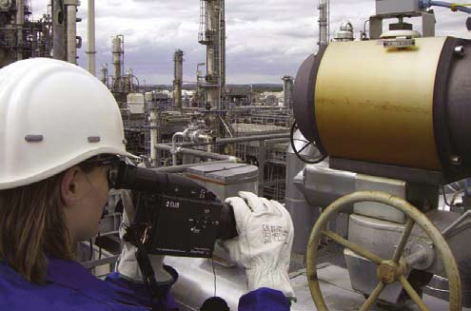
1. Leak Detection and Repair
The proposed regulations would require facility operators to implement a LDAR program, which would include:
maintaining an inventory of equipment components;
completing three inspections per year of all equipment components in the inventory;
repairing significant leaks within specified timelines; and
replacing components with repeated leaks

Slide 19
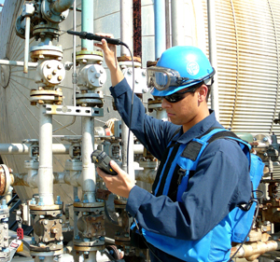
1. Leak Detection and Repair
Element | Proposed Approach
Coming Into Force | July 1, 2019
Coverage | Equipment components coming into contact with a fluid containing 10% or more VOCs
Exempted Equipment Components | Certain components with “leakless” design; components designated as unsafe to inspect
Frequency of Inspection | 3 times per year
Leak Definition | 10,000 ppmv until December 31, 2024; 1,000 ppmv thereafter
Inspection Methods | Infrared cameras, sniffers
Timelines for Repair | 15 days, unless shutdown or delay required
Replacement | Replace components having 3 significant leaks in 24 months

Slide 20
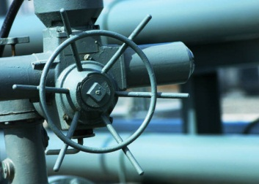
2. Preventive Equipment Requirements
The proposed regulations would require facility operators to ensure that certain equipment components meet design and operating requirements that would minimize releases into the environment
Element | Proposed Approach
Coming Into Force | July 1, 2019
Open-Ended Lines | Must be plugged at all times
Sampling Systems | Must be designed and used in a manner that minimizes the release of VOCs
Pressure Relief Devices | Must be designed and used in a manner that minimizes the release of VOCs; must be reset within 6 days of a pressure release
Compressors | Must be equipped with a mechanical seal system that has a barrier fluid system, or with a closed-vent system to capture releases

Slide 21
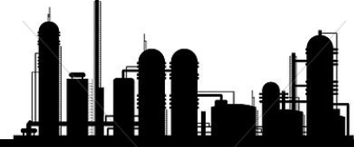
3. Fenceline Monitoring
The proposed regulations would require facility operators to monitor VOC concentrations at the facility perimeter
Element | Proposed Approach
Coming Into Force | January 1, 2018 (Monitoring begins July 1, 2018)
Number of Stations | Generally 12-18, depending on size and shape of facility
Frequency | Samples collected every 14 days from April 1 to December 22
Sampling and Analysis | Procedures and specifications in accordance with US EPA Methods 325A and B
Substances Analyzed | Benzene, 1,3-butadiene and “total retainable VOCs”

Slide 22
4. Training, Record-Keeping, Reporting and Auditing
The proposed regulations would require facility operators to undertake certain administrative activities
Element | Proposed Approach
Coming Into Force | Various dates (linked to other requirements)
Training | LDAR inspectors must be trained in calibrating, operating and maintaining their instruments
Record-Keeping | Records related to LDAR, preventive equipment requirements and fenceline monitoring must be kept at the facility for 5 years
Reporting | Annual reporting to ECCC on LDAR and fenceline monitoring activities
Auditing | Annual third-party audits

Slide 23
Collaborating with Partners and Stakeholders
ECCC has undertaken consultations during the development of the proposed VOC regulations:
Many of the requirements were adapted from the Base-Level Industrial Emissions Requirements (BLIERs) process for VOCs, which included detailed discussions with stakeholders from 2009-2012
In spring 2016, ECCC released a discussion paper for comment and organized webinars, follow-up meetings, etc.
The proposed regulations incorporate flexibilities and adjustments to address comments from stakeholders
Pre-publication in Part I of the Canada Gazette gives interested groups and individuals a final opportunity to review and comment on the proposed regulations before they are enacted

Slide 24
Anticipated Costs and Benefits
Important air quality benefits
The proposed regulations are expected to result in reductions of 102 kilotonnes of VOC emissions and 43 kilotonnes carbon dioxide equivalent (CO₂e) of greenhouse gas emissions
Premature mortality of 43 persons would also be avoided
Reduced exposure to toxics for Canadians living around facilities
Most facilities are located in and around urban centres and First Nations
Facility operators would incur costs to comply with the requirements, but would also recover products that would otherwise have been lost from leaking equipment
Total benefits are estimated at $313 million, while total costs are estimated at $254 million

Slide 25
NEXT STEPS

Slide 26
Next Steps for Methane and VOCs
The proposed regulations will be published in Canada Gazette, Part I on May 27, 2017
A 60-day public comment period will follow this publication
ECCC will continue to consult with provinces, territories, Indigenous peoples, industry, ENGOs and other stakeholders to develop the final regulations
Continue to work with interested provinces on equivalency and other collaborative agreements
The targeted publication dates for the final regulations in Canada Gazette, Part II, are in 2018

